Slide 1
An introduction to #rstats
through analysis
import > viz > prep > test

Slide 2
Section 1
Computer language overview
Building blocks of R
Classes/Types
Operators/Functions
Vectors/Lists/Data-frames
Notes:
REPRODUCIBLE RESEARCH, journals starting to require this

Slide 3
Why program?
Powerful way to work
Recordable/reproducible
Automation
You already know some programming languages
Math
+, -, *, ^, log
Excel formulas
=SUM(A1:A12)
Notes:
REPRODUCIBLE RESEARCH, journals starting to require this

Slide 4
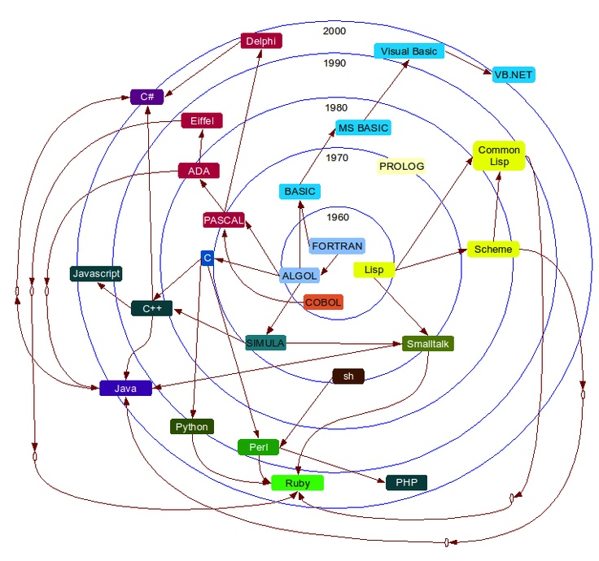
Language Genealogy
All attempt to describe logic
Providing exact instructions is hard
Think about the complexity of cooking a meal.
Each is focused on solving a different problem
Popularity varies
Application varies
Style varies
R
https://github.com/stereobooster/programming-languages-genealogical-tree/blob/gh-pages/img/radial.jpg
Notes:
**Ask audience to name languages**
Discuss recipe with group for three minutes.
Did you describe where to purchase the ingredients? How the ingredients were farmed/created?
Inheritance doesn’t mean much now, but remember all languages are related.
Learning the second one is a lot easier because of this.

Slide 5

Why R?
Built for data
Developed in New Zealand
Wonderful community
https://en.wikipedia.org/wiki/R_(programming_language)

Slide 6
What are you doing tonight?
https://rstudio.cloud/project/411105
Notes:
The best way to learn a language is to speak/use it
Ten minutes a day is great way to get addicted
Cloud is great
Make sure you fork/save this image as your own once you log in

Slide 7
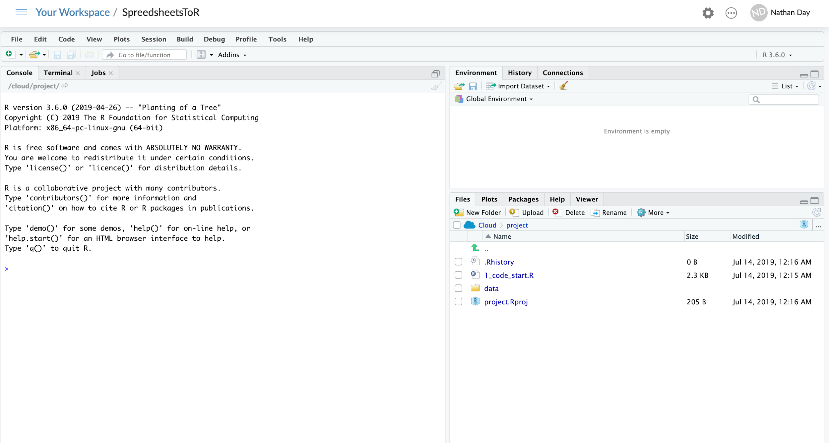
R Studio layout
See variables
(environment)
Execute code
(console)
Browse files
(file system)

Slide 8
First things first...

Slide 9
Operators
Define <-
Arithematic +, -, *, /, ^
Range 1:3
Index [1], [[2]]
Tabular-index [x, y], [row, column]

Slide 10
functions()
More complex
Multiple steps wrapped into one name
Take arguments
Return something new
Predefined*
Have help pages
See one… ?class()
Notes:
Functions used *in this workshop* are all pre-defined
Take advantage of things people have built

Slide 11
?help_pages()

Slide 12
Types & Classes
Both control behavior, but on different levels
Most of the time class() is enough....
Types (low-level / memory storage) | Classes (high-level / object properties)
Numeric Integer Real Complex Character Logical | A numeric can interact with the function `mean()` A character can not
Notes:
class() is useful debugging
Error message usually reference the type or class of an object
Error messages + Help pages = figuring out mistakes

Slide 13
Objects in R
Vectors | List | Data Frame
Must be all one type Indexed by length Will be coerced to most flexible type | Can hold anything Indexed by length or element | Special list Infinite number of elements all the same length Indexed by columns, rows or x,y coordinates

Slide 14
Section 2
Recap
Languages are unique, but related
Operators/Functions do things
Classes matter for doing things
Up next…
Getting more functions
Working with Excel data
Plotting with ggplot2

Slide 15
Packages
Collection of functions with a common purpose
Access other peoples solutions
Tested by a town
Lego bricks of usefulness
Notes:
A specialized set of tools for a task
Lots of the problems we see have been solved by other people
Community support means the product is well supported
Built to a spec so it always works together

Slide 16
Picking the right package
Google: “R package to {do something}”
“... read XLSX file”
“... make plots”
If multiple options exist:
Check when last updated
Star gazers
Notes:
Finding packages is easy, so is finding code solutions
Always prepend with a capital R
Packages are free to you, but cost someone’s time
Find ones that are being cared for
And have a community supporting them

Slide 17
Data in spreadsheets
Excel is ubiquitous
More complicated than a CSV
Access existing workflows/data-streams
Code records the interaction with a document
Ability to automate
Protect the original
Reproducible research

Slide 18
readxl
Reads both .xls and .xlsx
Control read in by:
Sheet - name or index
Rows
Columns
Notes:
Excel is ubiquitous for data recording and analysis

Slide 19
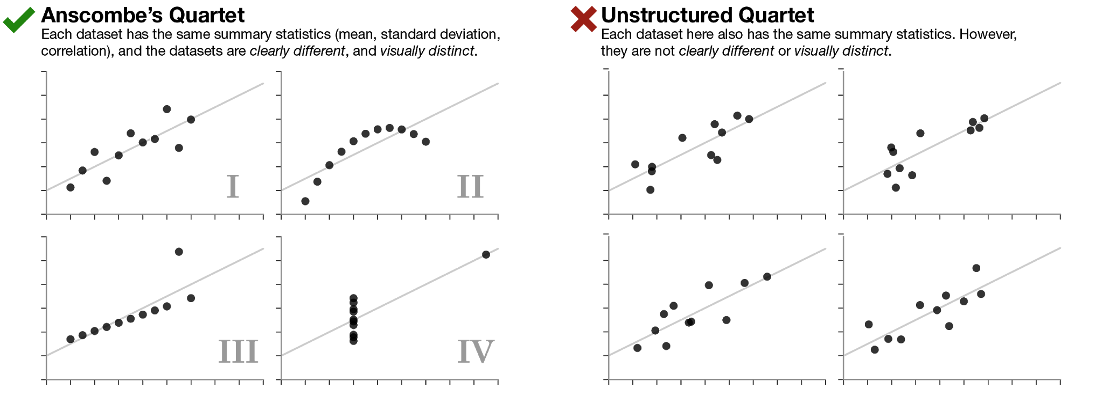
Anscombe’s quartet
https://www.autodeskresearch.com/publications/samestats

Slide 20
The Datasaurus Dozen
https://www.autodeskresearch.com/publications/samestats

Slide 21
Data visualization
Critical to EVERY analysis
Exploration
Look for patterns
Evaluation
Model a change
Validation
Check model behaves

Slide 22
ggplot2
Implements the Grammar of Graphics
Plots are built in layers
Layers are stacked with the + operator
Works on columns of a data frame
Notes:
The + operator here is different than arithmatic
In the context of a ggplot call its about adding layers together
BC data frames are central object in R, ggplot functions are designed to easily operated with them.
Columns can be directly connected to va

Slide 23

ggplot(data = NULL, mapping = aes()) + ...
Creates a new plot
Returns the foundation layer
Every added layer listens to this one
Cascades down until you stop it
aes() is special
https://www.shopbecker.com/blocks-and-manipulatives/lego-and-duplo/_/lego-small-building-plates/?
Notes:
Building plate for the plot
Layers will stack to this one
Like a mothership?

Slide 24
aes(x, y, ...)
Construct aesthetic mapping
Returns a legend and required scales
Allows name reference to columns in data
Scales supported:
Color (outline)
Size
Alpha (transparancy)
Shape (categorical only)
Fill (interior)
Stroke (outline size of points)
Linetype
Notes:
This is where you drive the viz
Using appropriate scales for your variables is key
Changing scales around is a good way to explore relationships in a dataset

Slide 25
geom_someshape(mapping = NULL) + ...
Adds a new layer on top
Creates the useful part / carries information
Mapping cascades down from ggplot() +
Redefine a mapping variable to override the cascade
NULL with remove an existing mapping without re-assigning
Infinitely stackable
Notes:
Snaps to the building plate
Build as high as you want
But at somepoint it should be two plots

Slide 26
stat_summary()
Specialized layer
Assumes a grouping
Performs summary statistics
Adds new layer with those results
Summary functions are adjustable
Specified on new variables on y-axis
Can calculate 1 (y) or 3 (ymin/y/ymax) values
So are resulting geoms
Must match values created by summary function
Point ~ 1 value
Crossbar ~ 3 values
Notes:
Group can be loosely inter

Slide 27
labs(...)
Modify axis, legend, and plot labels
Critical for readability/usefulness
Column names are usually not suitable by themselves
Notes:
BC of the syntax R enforces its rare that you have column names (that are easy to work with in R!) that are ready read as English (spaces, punctuation, capitalization)

Slide 28
Section 3
Recap
Packages exist for everything*
Data viz is always important
ggplot is a language of layers
Up next…
Data wrangling
Sort
Subset
Summarize
Augment

Slide 29

There’s an R package for dat
dplyr - dee-plier
Language of data frame manipulation
select() picks/drops columns
arrange() sorts rows
filter() picks/drops rows
mutate() adds new columns
summarise() adds new collapsed columns
Share the same pattern
https://dplyr.tidyverse.org/index.html
Notes:
Actually there are lots of packages, this is just my favorite.

Slide 30
select(.data, ...)
datf | columnA | columnB
1 | 4 | 9
2 | 10 | 5
3 | 8 | 3
4 | 6 | 7
Keep columns of .data
... column names
-column_name removes column
Allows rearrangement of columns
Helper functions to select multiple at once
starts_with(‘a pattern’)
ends_with(‘a pattern’)
matches(‘another pattern’)
select(datf, columnB)
datf | columnB
1 | 9
2 | 5
3 | 3
4 | 7

Slide 31
arrange(.data, ...)
datf | columnA | columnB
1 | 4 | 9
2 | 10 | 5
3 | 8 | 3
4 | 6 | 7
Sort .data by column(s)
... column names
Default is ascending order
Use `desc(column_name)` to get descending order
arrange(datf, columnA)
datf | columnA | columnB
1 | 4 | 9
2 | 6 | 7
3 | 8 | 3
4 | 10 | 5

Slide 32
slice(.data, ...)
datf | columnA | columnB
1 | 4 | 9
2 | 10 | 5
3 | 8 | 3
4 | 6 | 7
Keep rows of .data by index(s)
... integers
Negative values remove rows
slice(datf, 2:3)
datf | columnA | columnB
2 | 10 | 5
3 | 8 | 3

Slide 33
filter(.data, ...)
datf | columnA | columnB
1 | 4 | 9
2 | 10 | 5
3 | 8 | 3
4 | 6 | 7
Keep rows of .data by logical(s)
... conditionals
==
>, <, >=, <=
Any function that returns TRUE/FALSE
Linked by AND `&` or OR `|`
filter(datf, columnA < 7)
datf | columnA | columnB
1 | 4 | 9
4 | 6 | 7

Slide 34
mutate(.data, ...)
datf | columnA | columnB
1 | 4 | 9
2 | 10 | 5
3 | 8 | 3
4 | 6 | 7
Add new column(s) to .data
... name = values pairings
All `values` must be of length 1 or nrow(.data)
Single values will be repeated
Usually the result of a function
mutate(datf,
columnC = sum(columnA, columnB))
datf | columnA | columnB | columnC
1 | 4 | 9 | 13
2 | 10 | 5 | 15
3 | 8 | 3 | 11
4 | 6 | 7 | 13

Slide 35
group_by(...)
datf | batch | tx | conc
1 | A | veh | 9
2 | A | drug | 5
3 | B | drug | 3
4 | B | veh | 7
... column(s) to set sub-grouping
Only useful when paired with other functions
Remember stat_summary()?
Can be used with:
arrange()
slice()
filter()
mutate()
summarise()
group_by(datf, batch)
datf | batch | tx | conc
1 | A | veh | 9
2 | A | drug | 5
3 | B | drug | 3
4 | B | veh | 7

Slide 36

%>%
The “pipe” operator
Useful for linking functions together
Helpful for breaking out nested function calls
Carries the result of function1 into a argument for function2
Rene Magritte, The Treachery of Images, 1929

Slide 37
summarise(.data, ...)
datf | batch | tx | conc
1 | A | veh | 9
2 | A | drug | 5
3 | B | drug | 3
4 | B | veh | 7
Add new columns to .data
Remember mutate()?
Collapses all rows in a group to a single row
... new_column_name = new_values pairings
new_values must be single value
Usually the result of a function
group_by(datf, tx)
datf | batch | tx | conc
1 | A | veh | 9
2 | A | drug | 5
3 | B | drug | 3
4 | B | veh | 7
summarise(datf, conc = mean(conc))
 | tx | conc
1 | veh | 8
2 | drug | 4

Slide 38
Section 4
Recap
Subset data
Calculate new values
Link multiple functions
Up next
Statistical tests
Formulas
Bringing it all together

Slide 39
Capstone
Get data out of ‘curveball.xlsx’
Combine all sheets into one data frame
See the treatment effect
Show all of the data points
Show some group statistics
Summarise as a results table
By group calculate: n, mean, standard deviation
Test your hypothesis
T-test
Linear model
Build a final plot with results

Slide 40
Formulas
Special R syntax for models
Reference columns in data by name
Left Hand Side ~ Right Hand Side
Response ~ Predictor(s)

Slide 41
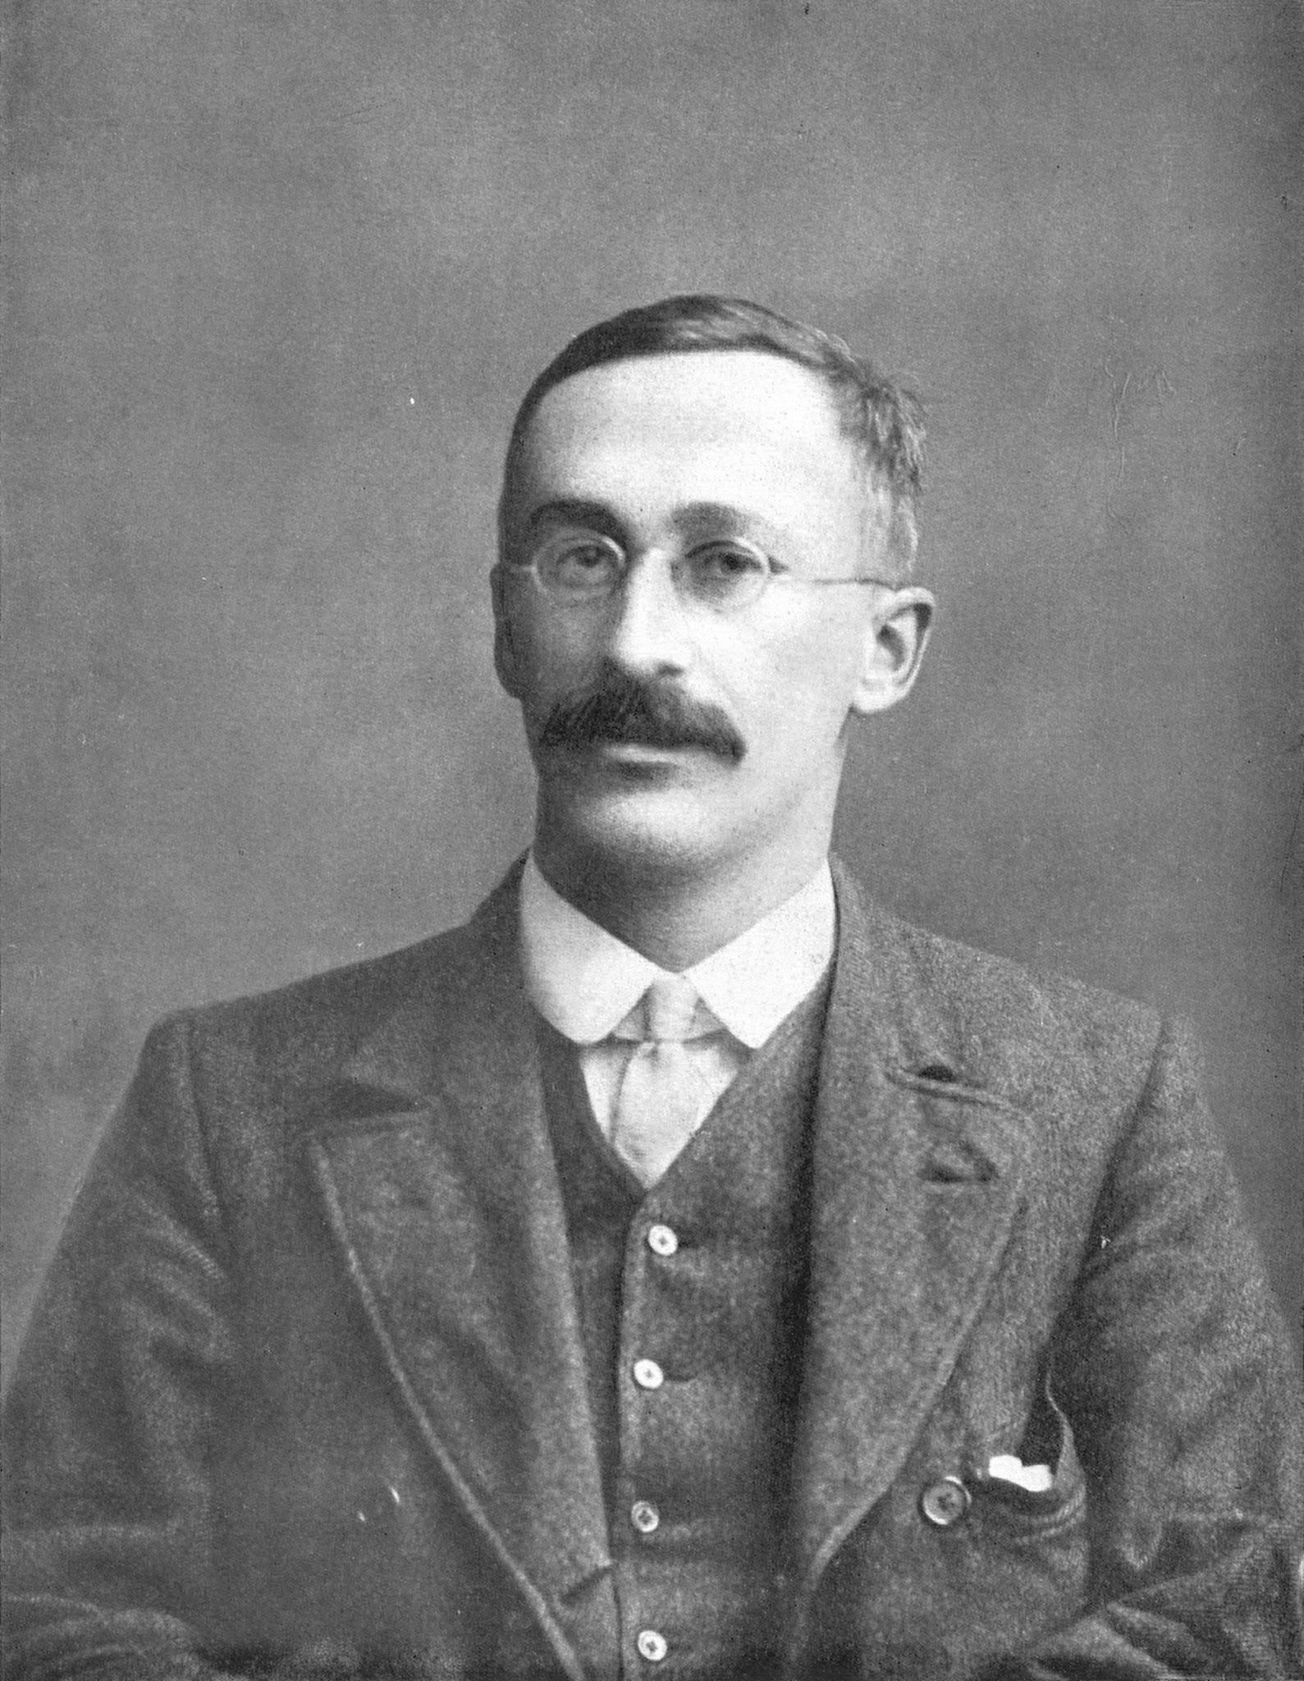
t.test(formula, data)
Are groups different?
Is one group different than zero?
Are two groups different from each other?
Focused on working with small samples
Developed to monitor quality of stout at Guinness brewery
William Sealy Gosset published under a pen-name Student, due to company policy against publishing
Friends with both Karl Pearson and R.A. Fischer
https://en.wikipedia.org/wiki/Student%27s_t-test

Slide 42
lm(formula, data)
lm = linear model
Estimate relationship response and predictor(s)
Two main uses:
Prediction - forecasting
Explanation - quantify strength of relationships
This is machine learning

Slide 43
Thanks for learning!
Github repository
https://github.com/nathancday/Spreadsheet-to-Rstats
Rstudio Cloud
https://rstudio.cloud/project/411105

